Slide 1
VLSI Test Principles and Architectures
Chapter 10, Boundary Scan and Core-Based Testing
Haochen Ding

Slide 2
INTRODUCTION
00

Slide 3
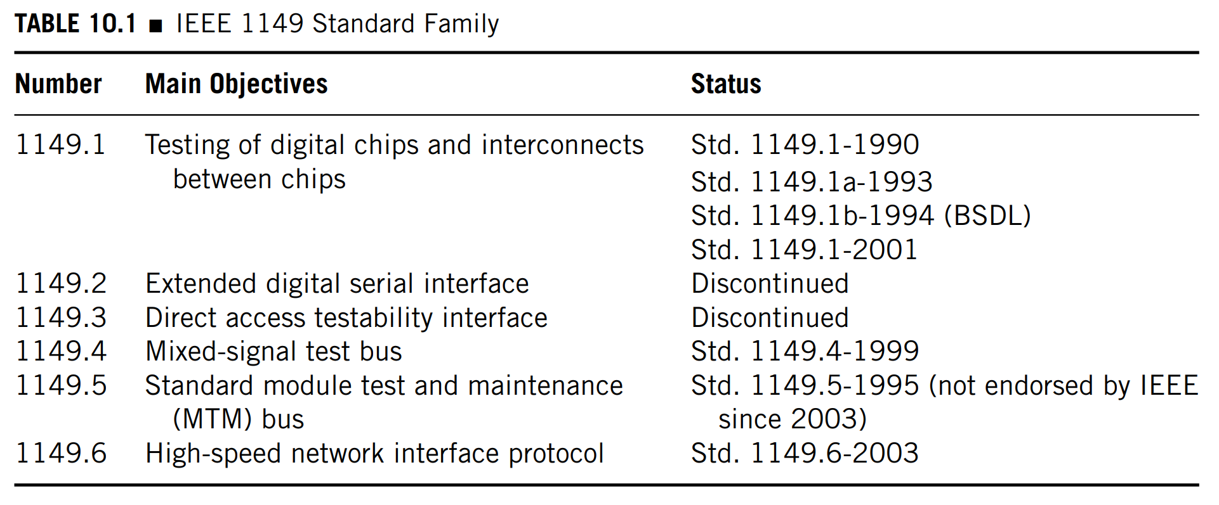
00 Introduction
With the advent of surface mount packages and multiple chip modules (MCMs), this method becomes infeasible as no or few through-hole pins are available for probing.
The best way to address this problem is to chain all the boundary I/O pins of a chip into a shift register and use a concept similar to scan design to gain back the I/O accessibility of the chip.

Slide 4
00 Introduction
The 1500 standard is similar to 1149.1 in that:
The main objective of the 1149.1 standard is to standardize boundary test circuitry (called wrappers) for cores. The 1500 standard, however, further provides parallel access capability for a core so test efficiency for an SOC can be significantly improved.
Furthermore, unlike 1149.1, where control signals are mainly generated by a finite state machine that is controlled by a single input, in 1500 the control signals can be directly applied to a core, thus providing more test flexibility.

Slide 5
00 Introduction – Contents of This Chapter
01 Digital Boundary Scan (IEEE Std. 1149.1)
02 Boundary Scan for Advanced Network (IEEE Std. 1149.6)
03 Embedded Core Test Standard (IEEE Std. 1500)
04 Comparisons between the 1500 and 1149.1 Standards

Slide 6
Digital Boundary Scan (IEEE Std. 1149.1)
01

Slide 7
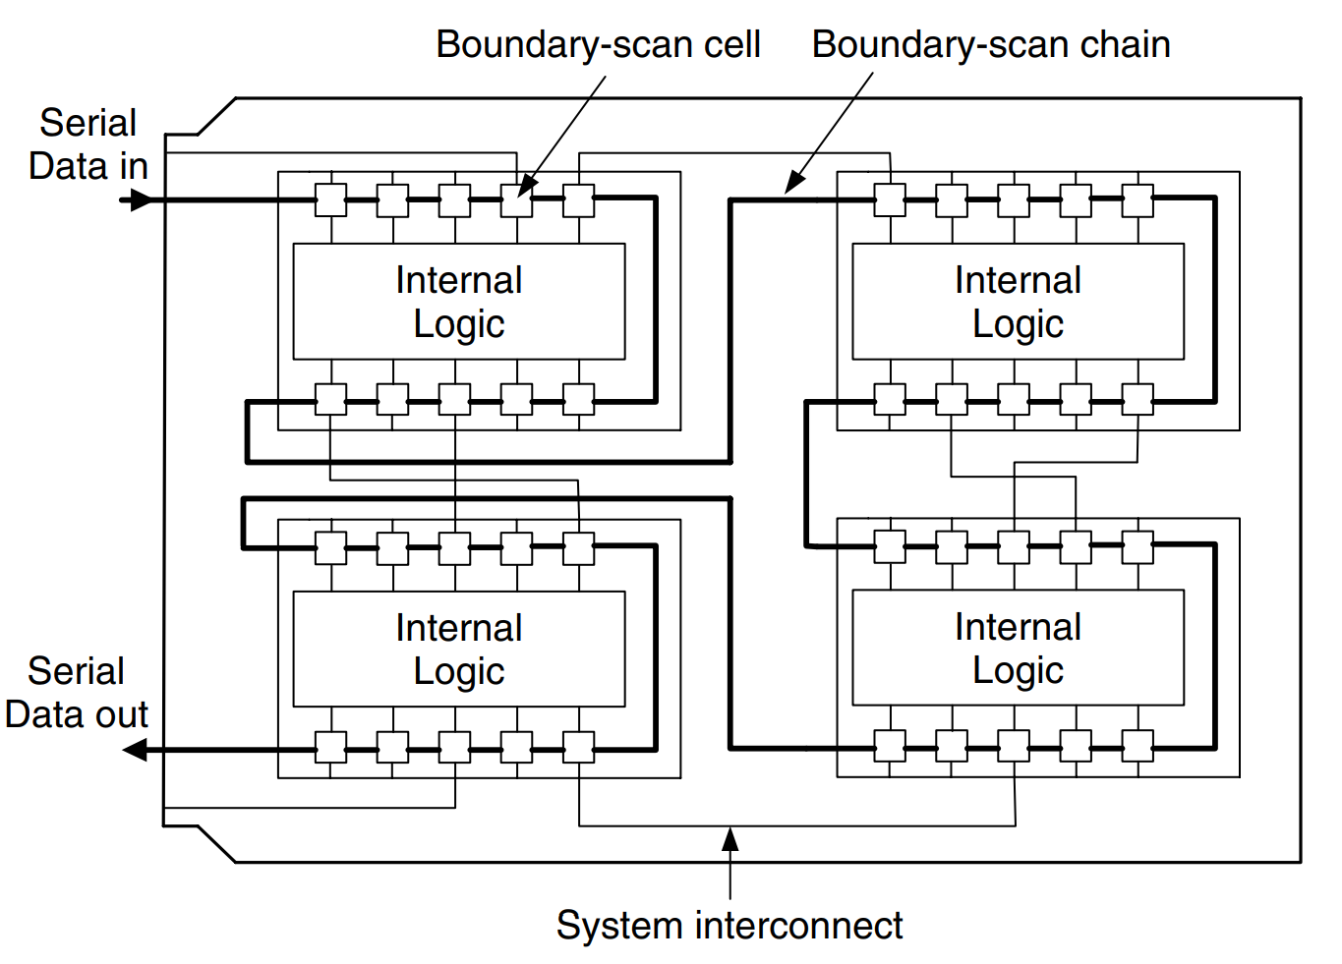
01 Digital Boundary Scan (IEEE Std. 1149.1)
Basic Concept
Boundary-Scan Register: The name boundary scan is due to the insertion of a boundary-scan cell to each I/O pin of the original circuit and the chaining of these cells into a shift register called the boundary-scan register.
Boundary-Scan Chain: The boundary-scan registers are interconnected into a single boundary-scan chain.

Slide 8
01 Digital Boundary Scan (IEEE Std. 1149.1)
Basic Concept
Through this chain, the I/Os of each chip are controllable and observable via serial scan and Capture/Update operations, thereby enabling the testing of internal logic of each chip as well as interconnects among the chips.
In addition, 1149.1 also provides the important feature where the data capturing and shifting can be done on the boundary-scan logic without interfering with the normal circuit operations.

Slide 9
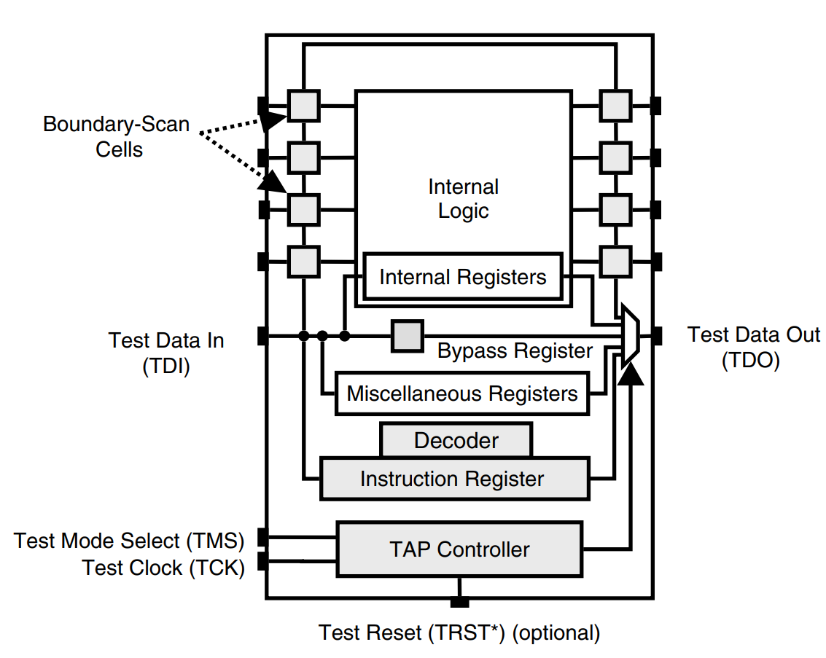
01 Digital Boundary Scan (IEEE Std. 1149.1)
Overall 1149.1 Test Architecture and Operations
The boundary-scan circuitry can be divided into four main hardware components:
A test access port (TAP), which consists of five mandatory terminals:
test data input (TDI)
test data output (TDO)
test mode select (TMS)
test clock (TCK)
test reset (TRST∗) (optional)
A TAP controller (TAPC)
An instruction register (IR) and its associated decoder
Several test data registers, including the mandatory boundary-scan register and bypass register, and some optional miscellaneous registers, such as the device-ID register, and some design-specific test data registers

Slide 10
01 Digital Boundary Scan (IEEE Std. 1149.1)
Overall 1149.1 Test Architecture and Operations
The test access port, which defines the bus protocol of the boundary scan, consists of additional I/O pins necessary for each chip employing the standard.
The TAP controller is a 16-state, finite-state machine that controls each step of the boundary-scan operations.
Each instruction to be carried out by the boundary-scan architecture must be serially loaded into the instruction register through the test data input (TDI) pin.

Slide 11
01 Digital Boundary Scan (IEEE Std. 1149.1)
Overall 1149.1 Test Architecture and Operations
IEEE Std. 1149.1 also defines a set of test instructions, including:
Four mandatory ones. (BYPASS, SAMPLE, PRELOAD, and EXTEST)
Several optional ones, including INTEST, RUNBIST, CLAMP, IDCODE, USERCODE, and HIGHZ.
It also allows the users to define their own instructions.

Slide 12
01 Digital Boundary Scan (IEEE Std. 1149.1)
Overall 1149.1 Test Architecture and Operations
Test procedure outline:
A boundary-scan test instruction is shifted into the IR through the TDI.
The instruction is decoded by the decoder associated with the IR to generate the required control signals so as to properly configure the test logic.
A test pattern is shifted into the selected data register through the TDI and then applied to the logic to be tested.
The test response is captured into some data register.
The captured response is shifted out through the TDO for observation and, at the same time, a new test pattern can be scanned in through the TDI.
Steps 3 to 5 are repeated until all test patterns are shifted in and applied, and all test responses are shifted out.

Slide 13
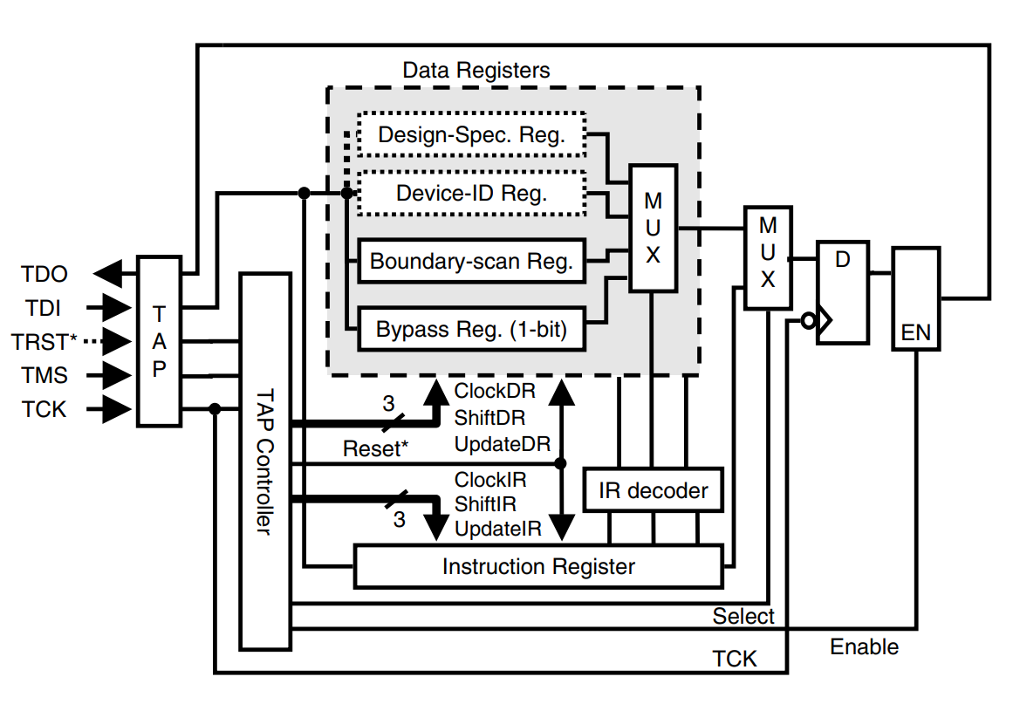
01 Digital Boundary Scan (IEEE Std. 1149.1)
Test Access Port and Bus Protocols
Test Data Input (TDI)
It is an input to allow test instructions and test data to be serially loaded into the instruction register and the various test data registers, respectively.
Values presented at TDI are clocked into the selected register on a rising edge of TCK.

Slide 14
01 Digital Boundary Scan (IEEE Std. 1149.1)
Test Access Port and Bus Protocols
Test Data Output (TDO)
It is an output to allow various test data to be driven out.
Changes in the state of the signal driven through TDO should occur only on the falling edge of TCK.
The TDO driver must be set to its inactive driving state except when the scanning of data through this terminal is in progress.
Note that data should be propagated from TDI to TDO without inversion.

Slide 15
01 Digital Boundary Scan (IEEE Std. 1149.1)
Test Access Port and Bus Protocols
Test Clock Input (TCK)
It is a clock input to synchronize the test operations between the various parts of a chip or between different chips on a PCB.
This input must be independent of the system clocks so the serial test data path between components of a chip or different chips can be used independently of the system clocks.

Slide 16
01 Digital Boundary Scan (IEEE Std. 1149.1)
Test Access Port and Bus Protocols
Test Mode Select (TMS)
It is the sole test control input to the TAP controller.
All boundary-scan test operations such as shifting, capturing, and updating of test data are controlled by the test sequence applied to this input.
Signals presented at TMS are sampled by the TAP controller on the rising edge of TCK. It is also expected that the bus master will change the signal driven to the TMS input on the falling edge of TCK.
This input should also be driven to logic 1 when it is inactivated.

Slide 17
01 Digital Boundary Scan (IEEE Std. 1149.1)
Test Access Port and Bus Protocols
Test Reset (TRST*)
It is an optional pin used to reset the TAP controller.
If the TRST∗ pin is implemented, the TAP controller can be asynchronously reset to the Test–Logic–Reset controller state when a logic 0 is applied at TRST∗.
This in turn will reset other boundary-scan logic to the state required by the Test–Logic–Reset state.
This pin should not be used to reset the system logic so the test logic can be reset independently of the on-chip system logic.
If this input is omitted, the system must have some circuitry that can reset the TAP controller during power-on.

Slide 18
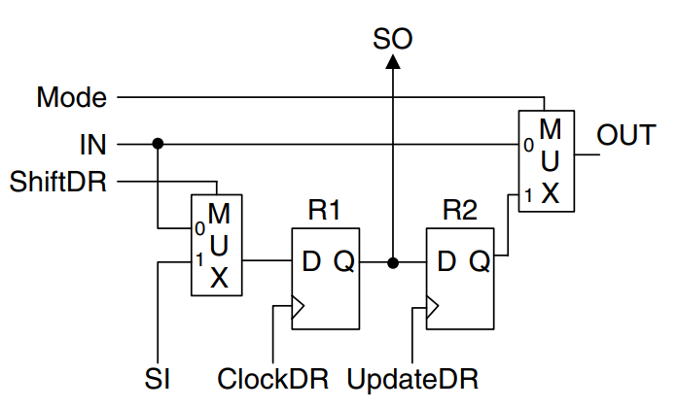
01 Digital Boundary Scan (IEEE Std. 1149.1)
Data Registers and Boundary-Scan Cells
Two mandatory test data registers: the boundary-scan register and the bypass register: must be included in any boundary-scan architecture. Other registers, such as the device identification register and design-specific test data registers, can be added optionally.

Slide 19
01 Digital Boundary Scan (IEEE Std. 1149.1)
Data Registers and Boundary-Scan Cells
The boundary-scan register (BSR) is the collection of the boundary-scan cells (BSCs) inserted at the I/O pins of the original circuit.
As an input BSC, the IN signal line corresponds to a chip input pad, and the OUT signal line is tied to an input of the internal logic.
As an output BSC, IN corresponds to the output of the internal logic, and OUT is tied to an output pad. Data driven on the OUT signal are controlled by the Mode signal.

Slide 20
01 Digital Boundary Scan (IEEE Std. 1149.1)
Data Registers and Boundary-Scan Cells
During the normal mode operation (Mode = 0), data passes from IN directly to OUT and the cell is transparent to the functional logic.
In Test mode (Mode = 1), test data driven by the R2 flip-flop pass through the multiplexer to the OUT signal.

Slide 21
01 Digital Boundary Scan (IEEE Std. 1149.1)
Data Registers and Boundary-Scan Cells
The test operations of a BSC are controlled by three output signals of the TAP controller: ClockDR, ShiftDR, and UpdateDR. Three main test operations: Capture, Shift, and Update: are defined.

Slide 22
01 Digital Boundary Scan (IEEE Std. 1149.1)
Data Registers and Boundary-Scan Cells
In the Capture operation, ShiftDR is set to 0, one clock pulse is applied to ClockDR, and the test data at IN will be captured into the capture flip-flop.
In the Shift operation, ShiftDR is set to 1 and clock pulses are applied to ClockDR such that test data can be shifted in from SI and the test response can be scanned out through SO.
In the Update operation, the data stored in R1 are propagated to R2 (known as the update flip-flop) by applying a clock pulse to UpdateDR. If the Mode is set to 1 at this time, then the output of R2 is connected to OUT.

Slide 23
01 Digital Boundary Scan (IEEE Std. 1149.1)
Data Registers and Boundary-Scan Cells
The bypass register is a single-bit register that is used to bypass a chip when it is not involved in the current test operation. This can significantly reduce test time required to shift in/out test data through the long TDI–TDO path.

Slide 24
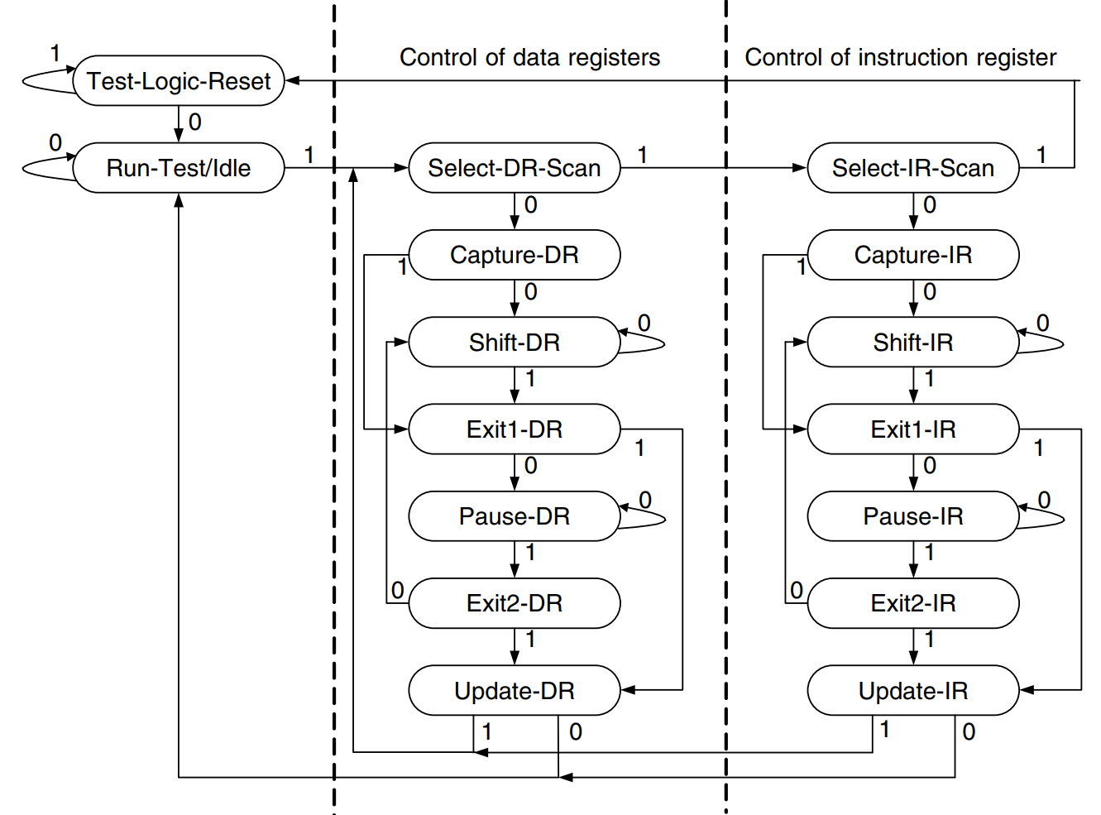
01 Digital Boundary Scan (IEEE Std. 1149.1)
TAP Controller (TAPC)
The main functions of the TAPC include:
Resetting the boundary-scan architecture
Providing control signals to load instructions into the instruction register
Providing signals to perform test functions such as Capture and Update (application) of test data
Providing control signals to shift test data from TDI to TDO

Slide 25
01 Digital Boundary Scan (IEEE Std. 1149.1)
TAP Controller (TAPC)
Test–Logic–Reset:
In this state the boundary-scan circuitry is disabled and the system operates in its normal mode.
Whenever a 0 signal is applied to the TRST∗ port, the TAPC enters this state.
Run-Test/Idle:
In this state, the boundary-scan circuitry is waiting for some test operations synchronized with the TCK (such as BIST) to complete.
It is different from the Test–Logic–Reset in that during this state activities on selected test logic may still be in progress.

Slide 26
01 Digital Boundary Scan (IEEE Std. 1149.1)
TAP Controller (TAPC)
Select-DR-Scan:
This is a temporary state in preparation for entering the data register manipulation column.
Capture-DR:
In this state, data can be loaded in parallel to the data registers selected by the current instruction. It is in this state where the current test results and normal operation status are captured.
Shift-DR:
In this state, test data are scanned in series through the data registers selected by the current instruction. Upon entering this state, the TAP controller will stay in this state as long as TMS = 0.

Slide 27
01 Digital Boundary Scan (IEEE Std. 1149.1)
TAP Controller (TAPC)
Exit-DR
This is also a temporary state. All parallel-loaded or shifted data are held in the selected data register in this state in preparation to enter the update or pause state.
Pause-DR:
The boundary-scan logic pauses its function here to wait for some external operations. It is a state that allows the boundary-scan architecture to wait for more data to shift in/out.

Slide 28
01 Digital Boundary Scan (IEEE Std. 1149.1)
TAP Controller (TAPC)
Exit2-DR:
This state either indicates completion of the current capturing/shifting operation, allowing the TAPC to enter the update state; or represents the end of the Pause-DR operation, allowing the TAP controller to go back to the Shift-DR state for more data to shift in/out.
Update-DR:
In this state, data are latched onto the parallel output of the selected test data registers from the shift register path on the falling edge of TCK.
Note that, with a two-stage register design, test data can be held at the parallel output of the selected register while other data are shifted in the associated shift register path.

Slide 29
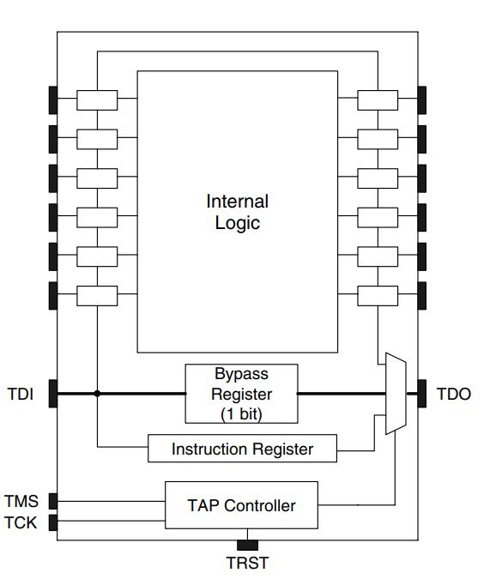
01 Digital Boundary Scan (IEEE Std. 1149.1)
Instruction Register and Instruction Set
BYPASS:
The BYPASS instruction is used to “bypass” the boundary-scan registers on unused chips so as to prevent long Shift operations.
The BYPASS register must capture a default bit of 0 at the Capture-DR state when this instruction is executed.
Furthermore, the instruction register must be forced to contain the BYPASS instruction whenever the TAP is reset, unless an IDCODE instruction (to be discussed later) is implemented, in which case IDCODE is the default instruction to be loaded to the BYPASS register.

Slide 30
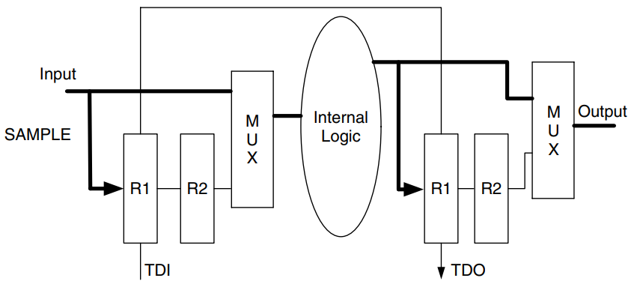
01 Digital Boundary Scan (IEEE Std. 1149.1)
Instruction Register and Instruction Set
SAMPLE:
The SAMPLE operation can be completed by simply executing the Capture operation (on the rising edge of TCK in the Capture-DR state) such that the required test data can be loaded in parallel to the selected data registers.
This instruction also allows the capture of the signals applied to the primary inputs of a chip and capture of the responses appearing at the output of the internal logic.
It is required that when the SAMPLE instruction is executed, the operation of the boundary-scan test logic must have no effect on the internal logic or on the flow of signals between the internal logic and the I/O pins of the chip.

Slide 31
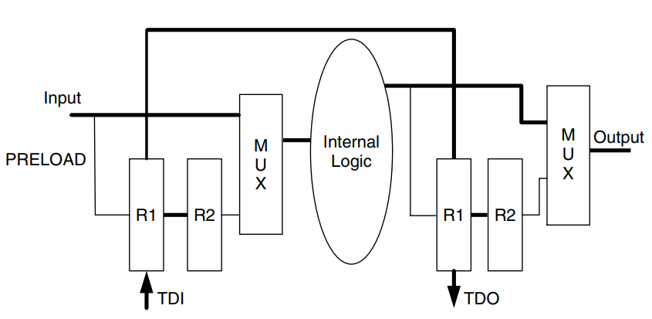
01 Digital Boundary Scan (IEEE Std. 1149.1)
Instruction Register and Instruction Set
PRELOAD:
The PRELOAD instruction allows test data to be shifted into or out of the selected data register during the Shift-DR state without causing interference to the normal operation of the internal logic.
The shifted data are then latched to the parallel output (R2) of the selected data registers (on the falling edge of TCK in the Update-DR controller state) for immediate or later use. This allows an initial data pattern to be placed at the latched parallel outputs of boundary-scan register cells using the PRELOAD instruction before the selection of another boundary-scan test operation.

Slide 32
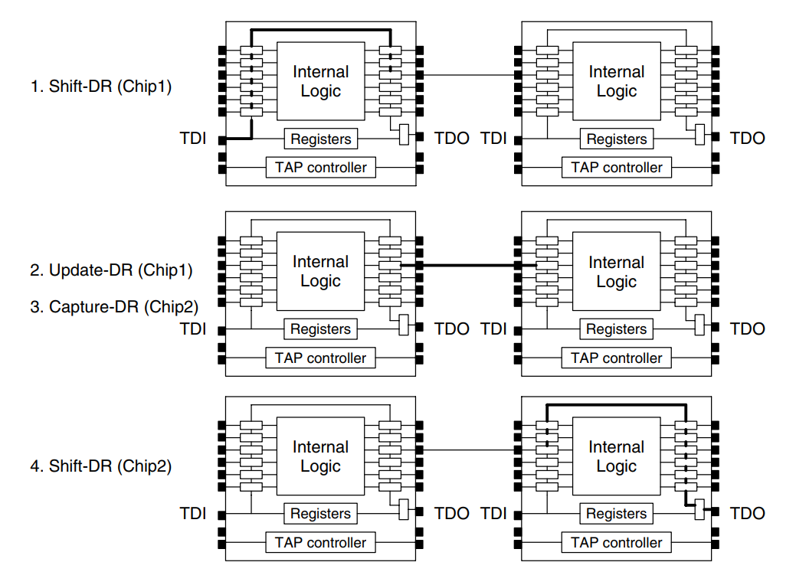
01 Digital Boundary Scan (IEEE Std. 1149.1)
Instruction Register and Instruction Set
EXTEST:
The EXTEST instruction is used to test the circuitry external to the chips, typically the interconnects between chips and between boards.
Before the selection of the EXTEST instruction, data can be loaded onto the latched parallel outputs using PRELOAD. Then, as soon as the EXTEST instruction has been transferred to the parallel output of the instruction register, the preloaded data are driven through the chip output pins.
This ensures that the required test data are driven immediately when the change to the EXTEST instruction takes place in the Update-IR controller state,

Slide 33
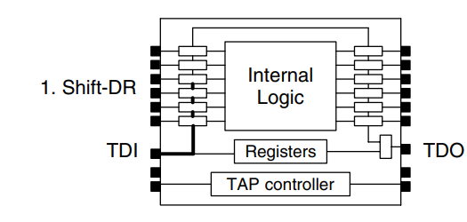
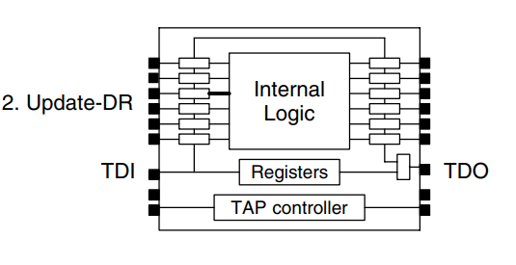
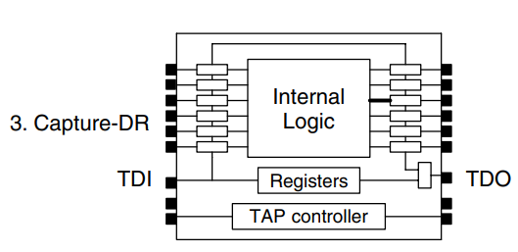
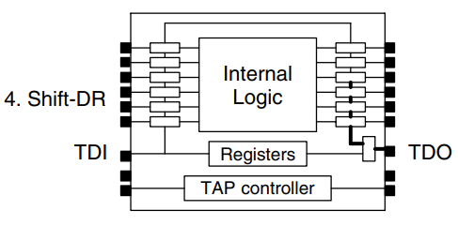
01 Digital Boundary Scan (IEEE Std. 1149.1)
Instruction Register and Instruction Set
INTEST steps:
Test data are shifted into the boundary-scan cells that drive internal logic.
An Update operation is then executed and the shifted data are loaded to the second stage of the boundary-scan cell. At the same time the data are applied to the internal logic.
The TAP controller then goes back to the Capture-DR state to capture the test result at the boundary-scan cells, which receive data from internal logic.
The Shift-DR operation shifts the test results out for observation. This operation may be repeated for several cycles.

Slide 34
01 Digital Boundary Scan (IEEE Std. 1149.1)
Instruction Register and Instruction Set
RUNBIST
The RUNBIST instruction provides a means of running a user-accessible self-test function within the chip using a single instruction. This permits all chips on a board that support the RUNBIST instruction to execute their own self-test process concurrently, thereby greatly reducing the total test time.
It is also permitted to include further private or public instructions which give access to individual self-test functions one at a time.
CLAMP:
When the CLAMP instruction is executed, the state of all signals driven from the output pins of the chip should be completely defined by the data held in the boundary-scan register, preferably in a “safe” state.
Similar to the BYPASS instruction, the CLAMP instruction also places only the BYPASS register between TDI and TDO, thus greatly reducing the shift length.

Slide 35
01 Digital Boundary Scan (IEEE Std. 1149.1)
Instruction Register and Instruction Set
IDCODE:
This instruction shall be provided when the optional 32-bit device identification register (device-ID register) is included in the chip.
When the IDCODE instruction is used, the vendor’s identification code prestored somewhere in the chip shall be loaded into the device-ID register.
USERCODE:
The USERCODE instruction allows a user-programmable 32- bit identification code to be loaded into the user-defined device-ID register and then shifted out for examination.
HIGHZ:
When the HIGHZ instruction is selected for a chip, all output pins of the chip shall be placed in an inactive state.

Slide 36
01 Digital Boundary Scan (IEEE Std. 1149.1)
Boundary Scan Description Language
This VHDL-compatible language provides information about how a boundary-scan IC is implemented, which can be used by ATPG software or system integrators to develop the test for the chip.
The tools can automatically generate the necessary boundary-scan circuitry as long as the specific boundary-scan information (such as the length of boundary-scan register, the user-defined boundary-scan instructions, the decoder for his or her own instructions, and the I/O pins assignment) for the chip is provided (in a setup file, for example).

Slide 37
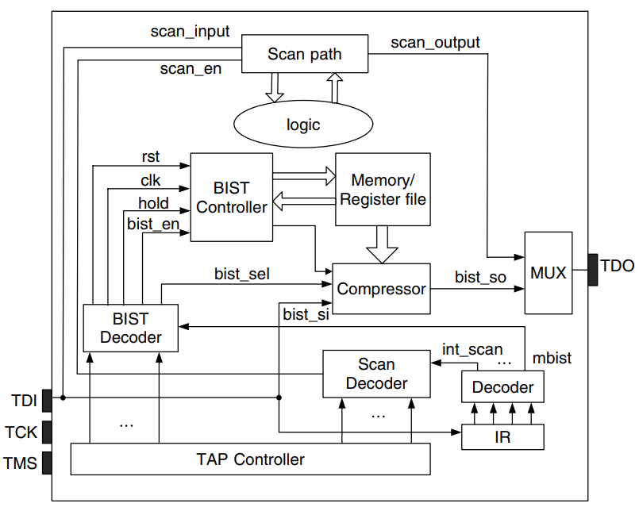
01 Digital Boundary Scan (IEEE Std. 1149.1)
On-Chip Test Support with Boundary Scan
A possible way to support DFT operations:
Add new test instructions for these operations such as RUNBIST and RUNSCAN.
One control line will be added for each new instruction and each time a new instruction is loaded into the IR the corresponding control line will be activated.
The control line can then be used to enable a decoder specifically designed for the instruction such that the control signals generated by the TAPC can be converted into the appropriate control signals required by the associated DFT circuitry.

Slide 38
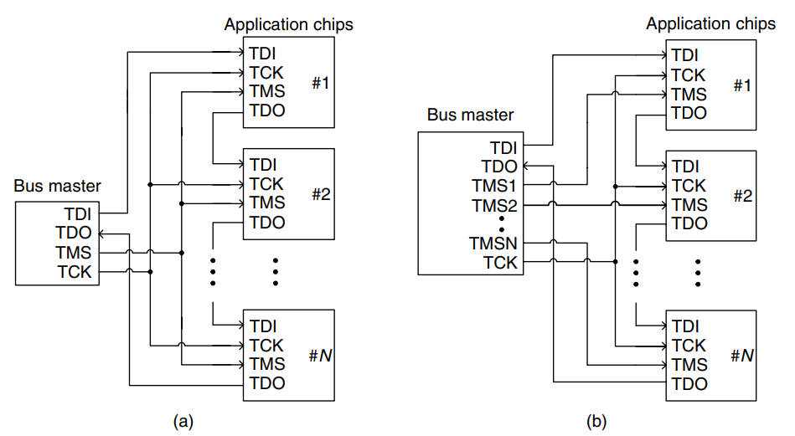
01 Digital Boundary Scan (IEEE Std. 1149.1)
Board and System-Level Boundary-Scan Control Architectures
Single-ring architecture with shared TMS: in this architecture, all boundary-scan registers of chips are daisy-chained together and the TMS signal is broadcast to all chips. All chips will always execute the same Capture, Shift, or Update operation under the control of the TAPC.
Single-ring architecture with separate TMS: in this architecture, each chip receives its own TMS signal, hence one can provide different instructions to different chips as well as operate the chips with different control signals.

Slide 39
01 Digital Boundary Scan (IEEE Std. 1149.1)
Board and System-Level Boundary-Scan Control Architectures
The single-ring architecture is easy to implement. It is generally sufficient to test chips on a single board. They do not require any additional components or new protocols.
The single-ring configuration may become inefficient for a system or backplane that contains a number of boards where each board contains ICs with boundary-scan architectures, due to the long and often cumbersome scan chain that has to pass through all chips in all boards.
This architecture also runs into problems when boards are removed or added, as some type of jumper or bridge is required when a board is removed; otherwise, the chain will be broken.

Slide 40
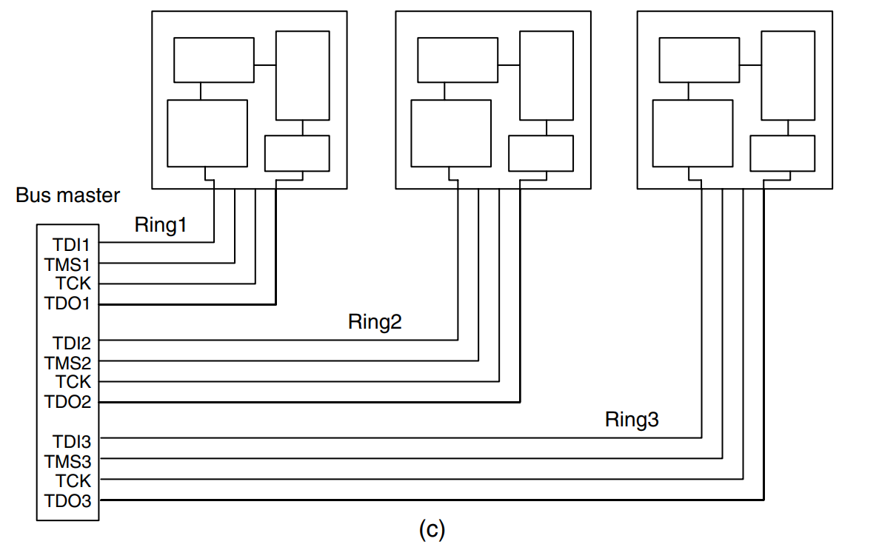
01 Digital Boundary Scan (IEEE Std. 1149.1)
Board and System-Level Boundary-Scan Control Architectures
Star (multi-ring) architecture: in the star-architecture, every board in the system gets a dedicated set of boundary-scan data and control signals. Though test for chips in each board can be efficiently carried out as if only a single board exists, such an approach requires a larger number of (connection) traces in the backplane.
Still it does not require any additional components or new protocols.

Slide 41
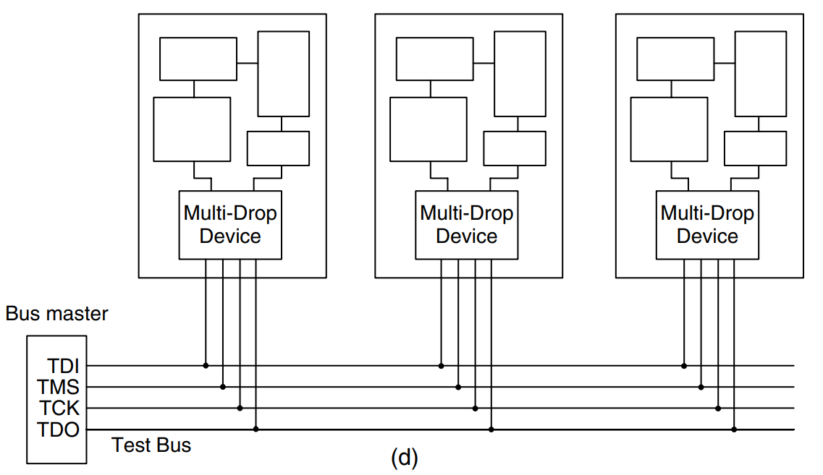
01 Digital Boundary Scan (IEEE Std. 1149.1)
Board and System-Level Boundary-Scan Control Architectures
Multidrop architecture: it uses only one set of 1149.1 data and control signals which is wired in parallel to each board in the system.
To ensure that boundary-scan operations are applied to only one board at a time, an addressable gateway device must be implemented on each board.
This solves the problems mentioned above at the expense of extra selection logic in each board.

Slide 42
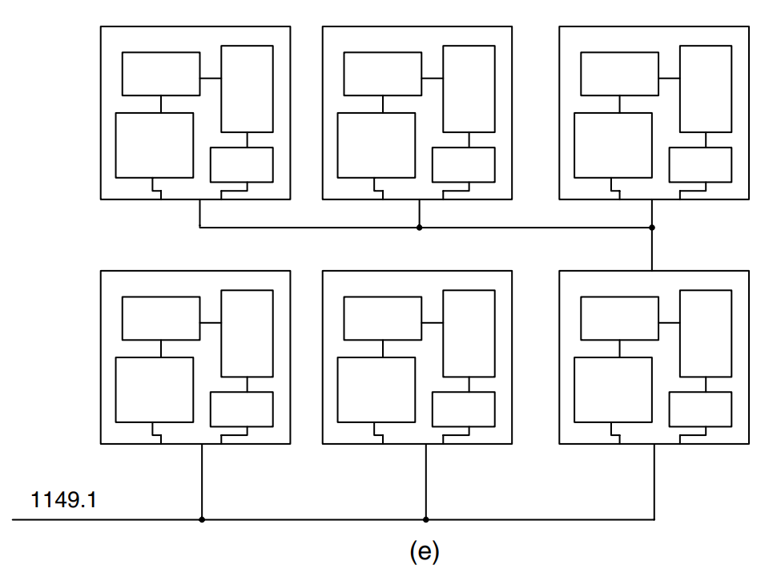
01 Digital Boundary Scan (IEEE Std. 1149.1)
Board and System-Level Boundary-Scan Control Architectures
Hierarchical architecture: it is essentially a nested test structure. By breaking the single chains into multiple hierarchical chains, chip access can become much more efficient.

Slide 43
Boundary Scan for Advanced Network (IEEE Std. 1149.6)
02

Slide 44
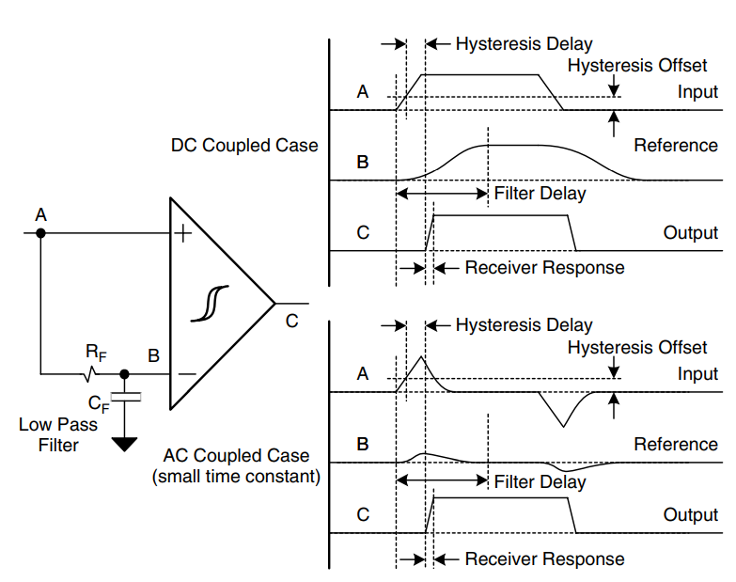
02 Boundary Scan for Advanced Network (IEEE Std. 1149.6)
1149.6 Analogue Test Receiver
It is the test receiver that is able to capture transition edges.
The challenge for the test receiver is to capture the edges without the noise immunity that is built into the differential receive.
A “self-referenced” comparator, along with voltage and delay hysteresis, is used to capture a valid edge and filter any unwanted noise.
A low-pass filter is used to create a delayed reference signal.

Slide 45
02 Boundary Scan for Advanced Network (IEEE Std. 1149.6)
1149.6 Digital Driver Logic
Unlike the 1149.1 driver, the 1149.6 driver is required to drive a pulse (or a sequence of pulses) when it is executing the 1149.6 EXTEST_PULSE (or EXTEST_TRAIN) instruction.
It simply extends the 1149.1 logic by multiplexing the 1149.6 signal into the 1149.1 shift/update circuit, after the update flip-flop.

Slide 46
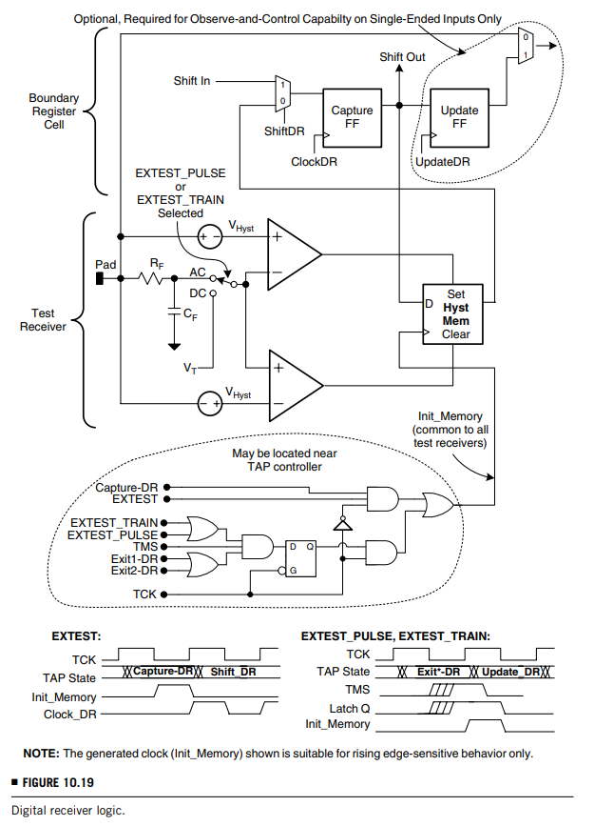
02 Boundary Scan for Advanced Network (IEEE Std. 1149.6)
1149.6 Digital Receiver Logic
The digital receiver logic takes the output of the analogue test receiver and sets a capture flip-flop to a corresponding logical zero or one.
Hysteresis Memory: The digital test receiver logic also ensures that a valid transition has been captured on every test vector by initializing the state of the capture memory prior to the transition being driven onto the net.
E.g. if a positive transition occurs and is captured in the memory, and the subsequent test vector also generates a positive transition, then there is no way to determine if the second transition occurred without clearing the contents of the hysteresis memory before it.

Slide 47
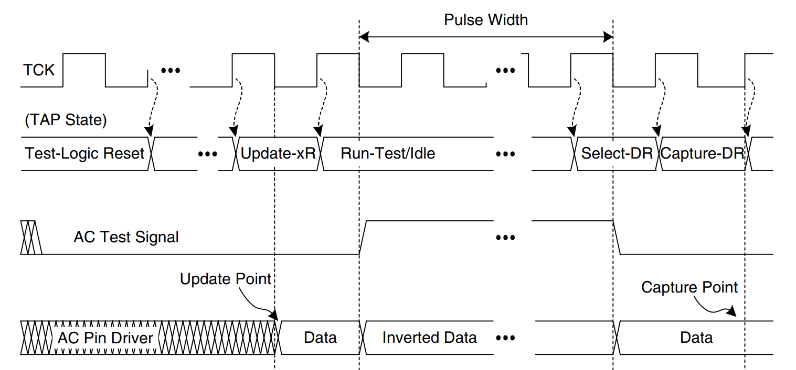
02 Boundary Scan for Advanced Network (IEEE Std. 1149.6)
1149.6 Test Access Port
It was determined that the 1149.6 TAP would require an excursion through the Run-Test/Idle state to allow for the generation of the pulse or pulses required by the EXTEST_PULSE and EXTEST_TRAIN instructions. The data signal is inverted and then allowed to fully decay in order to guarantee the maximum transition from the driver.

Slide 48
Embedded Core Test Standard (IEEE Std. 1500)
03

Slide 49
03 Embedded Core Test Standard (IEEE Std. 1500)
SOC (System-on-Chip) Test Problems
Mixing technologies: An SOC may contain cores with logic, processor, memory, and analogue design/manufacturing technologies. All of these cores must be tested after being manufactured.
Deeply embedded cores: A core may be deeply embedded in a chip. This requires some kind of test access mechanism (TAM) through which the core can be efficiently accessed and tested.
Hierarchical cores: A core itself may contain some cores in a hierarchical manner. A TAM only for cores at the top level of a hierarchy is insufficient.
Different core providers: Cores may come from different vendors. The cores available to the system integrator may be soft cores, hard cores, or firm cores.
Intellectual Properties protection/test reuse: Detailed internal structural information of a core is usually unavailable due to IP protection considerations.

Slide 50
03 Embedded Core Test Standard (IEEE Std. 1500)
SOC (System-on-Chip) Test Problems
Higher performance core I/Os than SOC pins: The clock rate inside a core can be significantly higher than what can be provided from SOC pins.
Expensive and inefficient external automatic test equipment (ATE): The specifications of ATE for testing digital, analogue, and memory devices are significantly different.
Long test application time: Clearly, long test application time is required if the cores in an SOC are tested sequentially.
Large test power: While great efforts have been devoted to low power design, test power issues have only recently gained attention.
Testable design automation: As SOC testing involves many new complicated problems, new DFT insertion tools that solve these problems are highly desirable.

Slide 51
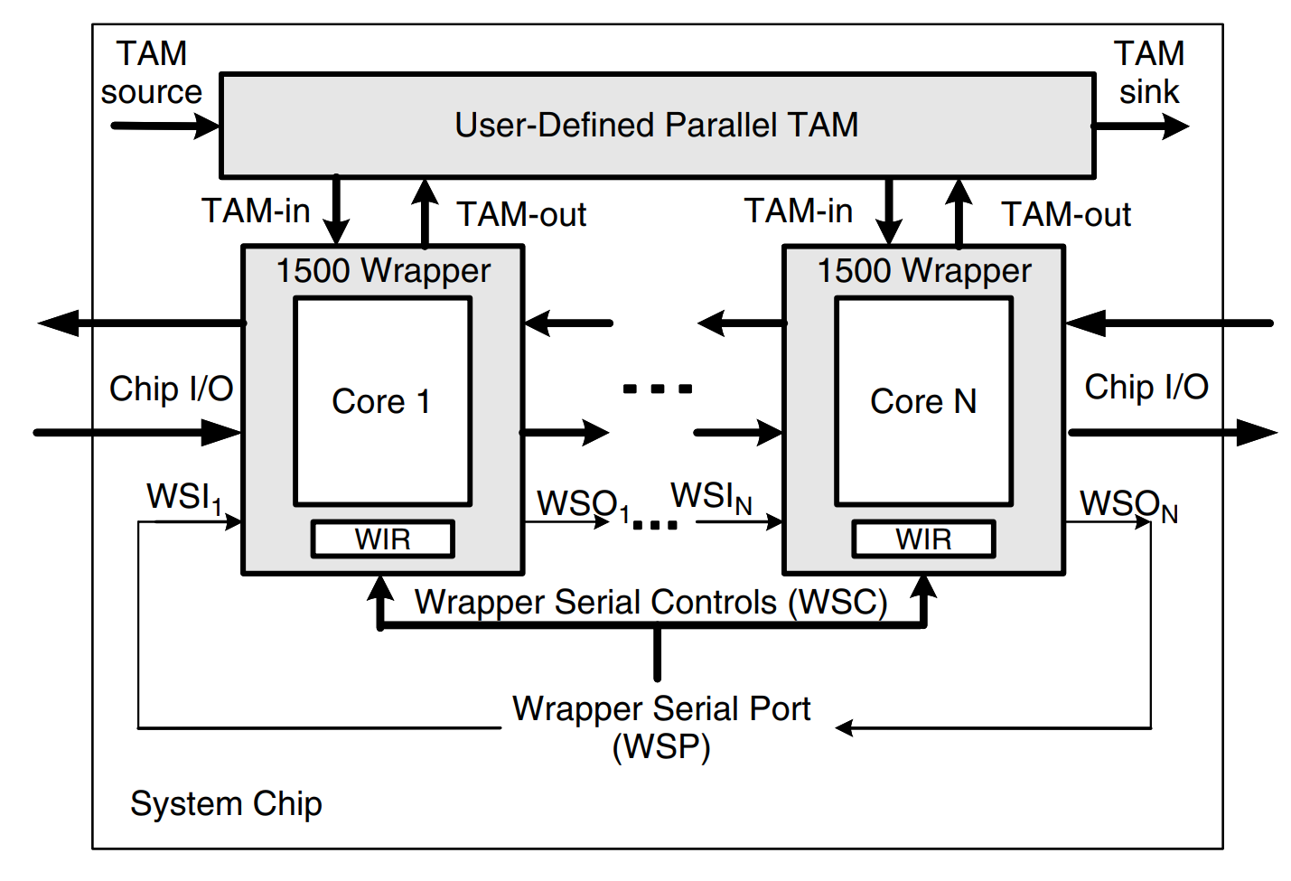
03 Embedded Core Test Standard (IEEE Std. 1500)
Overall Architecture
The most important feature of the 1500 standard is the provision of a wrapper on the boundary (I/O terminals) of each core, thereby allowing the test interface of the core to be standardized and the test commands to be executed.

Slide 52
03 Embedded Core Test Standard (IEEE Std. 1500)
Overall Architecture
The wrapper serial port (WSP) is a set of I/O terminals of the wrapper for serial operations. It consists of:
the wrapper serial input (WSI)
the wrapper serial output (WSO)
several wrapper serial control (WSC) terminals
Each wrapper has a wrapper instruction register (WIR), which is used to store the instruction to be executed in the corresponding core.

Slide 53
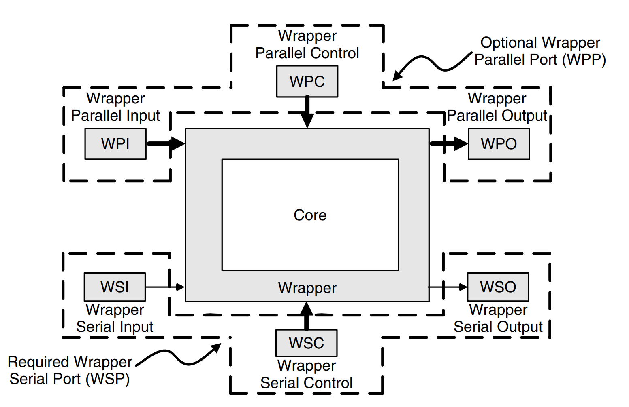
03 Embedded Core Test Standard (IEEE Std. 1500)
Overall Architecture
Test Access Mechanism (TAM): The 1500 standard also supports a parallel test mode by incorporating a user-defined, parallel test access mechanism (TAM). Each core can have its own TAM-in and TAM-out ports consisting of a number of data or control lines for parallel test operations.
The wrapper parallel control (WPC) and wrapper parallel input (WPI) signals correspond to the TAM-in port.
The wrapper parallel output (WPO) signals correspond to the TAM-out port.

Slide 54
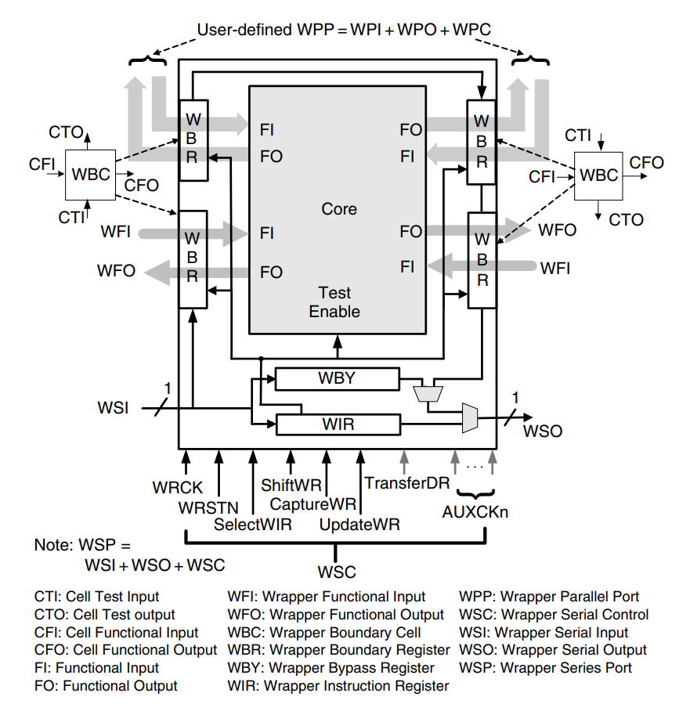
03 Embedded Core Test Standard (IEEE Std. 1500)
Wrapper Components and Functions
Wrapper serial port (WSP): it consists of a wrapper serial input (WSI), a wrapper serial output (WSO), and several wrapper serial control (WSC) terminals.
The WSC contains six mandatory control terminals (WRSTN, WRCK, SelectWIR, CaptureWR, ShiftWR, and UpdateWR), one optional control terminal (TransferDR), and some optional clock terminals (AUXCKn).

Slide 55
03 Embedded Core Test Standard (IEEE Std. 1500)
Wrapper Components and Functions
WRCK: This mandatory wrapper clock terminal is dedicated to the operation of the 1500 standard functions.
AUXCKn: These optional auxiliary 1500 clocks can be used for some implementations of wrapper boundary registers. The “n” indicates the number of these auxiliary clocks that shall be indexed by 1, 2, …, n. These clocks may be shared with the system clocks. When they are employed, the user must clearly define the timing relation between these signals and WRCK.

Slide 56
03 Embedded Core Test Standard (IEEE Std. 1500)
Wrapper Components and Functions
WRSTN: This mandatory wrapper reset terminal resets the wrapper circuitry and puts the wrapper into the normal system mode when asserted.
SelectWIR: This mandatory terminal is used to determine whether an instruction or data type of operation is to be performed.
When SelectWIR = 1, WIR is selected and connected between WSI and WSO.
Otherwise, some data register(s) is connected between WSI and WSO.

Slide 57
03 Embedded Core Test Standard (IEEE Std. 1500)
Wrapper Components and Functions
Wrapper parallel port (WPP): it consists of
User-defined wrapper parallel input (WPI) terminals
User-defined wrapper parallel output (WPO) terminals
User-defined wrapper parallel control (WPC) terminals
The clock terminals of WSC (the WRCK and AUXCK terminals)
All of these terminals are optional but may not replace other WSC terminals.

Slide 58
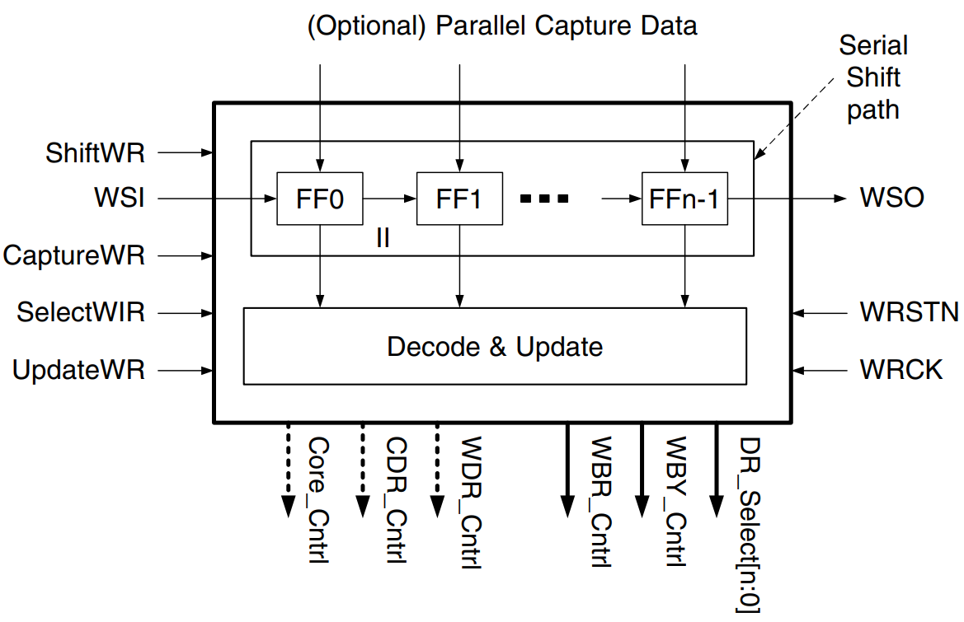
03 Embedded Core Test Standard (IEEE Std. 1500)
Wrapper Components and Functions
Wrapper instruction register (WIR): it is used to store the instruction to be executed, similar to the instruction register in 1149.1. However, there are two major differences:
First, because there is no finite-state machine in 1500, the control signals provided by the WIR are derived from both the current wrapper instruction and the current states of the signals connected to the WSC terminals.
The second difference is that, in addition to the serial shift-in operation of a new instruction through the WSI–WSO chain, the 1500 standard optionally provides a parallel load mode.

Slide 59
03 Embedded Core Test Standard (IEEE Std. 1500)
Wrapper Components and Functions
Wrapper boundary register (WBR): it consists of wrapper boundary cells (WBCs) similar to the boundary-scan register in 1149.1.
Each WBC has four data terminals:
cell functional input (CFI)
cell functional output (CFO)
cell test input (CTI)
cell test output (CTO)

Slide 60
03 Embedded Core Test Standard (IEEE Std. 1500)
Wrapper Components and Functions
Functional modes of WBR—Four modes are defined as follows:
Normal mode—The WBR is transparent to the system and the core executes its normal functions.
Inward facing mode—The test access is for the core itself; that is, the functional inputs of the core are controlled and the functional outputs of the core are observed by the WBR.
Outward facing mode—The test access is for external circuitry; that is, the wrapper functional outputs and the wrapper parallel outputs (of WPP) are controlled by the WBR, and the wrapper functional inputs and wrapper parallel inputs are observed (or captured) by the WBR.
Non-hazardous (safe) mode—The functional inputs of the core and wrapper functional outputs are controlled by WBR to a safe state.

Slide 61
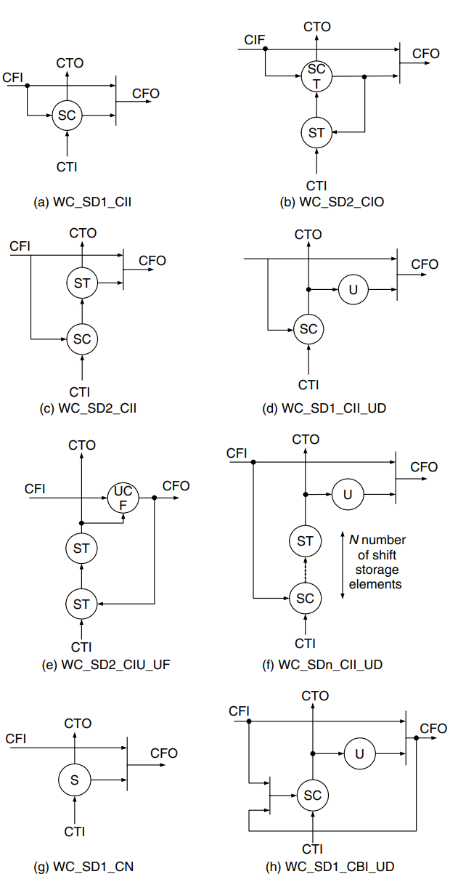
03 Embedded Core Test Standard (IEEE Std. 1500)
Wrapper Components and Functions
Operation events of WBR and WBC:
Shift event: a mandatory event whereby the data stored in the WBR shift path are advanced one storage position closer to the WBR’s serial test output.
Capture event: an event whereby the data present on the CFI or CFO of a WBC are captured and stored in a storage element within the WBC.
Update event: an optional event whereby data stored in a WBC’s shift path storage element closest to CTO are loaded into an off-shift-path storage element of the WBC.

Slide 62
03 Embedded Core Test Standard (IEEE Std. 1500)
Wrapper Components and Functions
Operation events of WBR and WBC:
Transfer event: an optional event that:
moves data to the storage element closest to the CTI of a WBC, if the data stored by the Capture event are not on this storage element.
moves the data one storage position closer to the CTO.
Apply event: a derivative event inferred from the operation of the other four events whereby test data become active and effective as test stimuli.

Slide 63
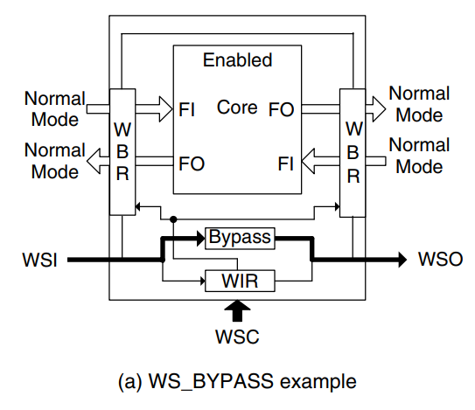
03 Embedded Core Test Standard (IEEE Std. 1500)
Instruction Set
W<S/P/H>_<Command>{_<Configuration>}:
The first “W” is the preface for all 1500 instructions.
S, P, and H represent the serial, parallel, and hybrid test modes, respectively.
Command represents the operation of the instruction.
Configuration describes the test configuration selected by the instruction.
WS_BYPASS:
This mandatory instruction is used to bypass the test information and enables the normal functional configuration of the wrapper.

Slide 64
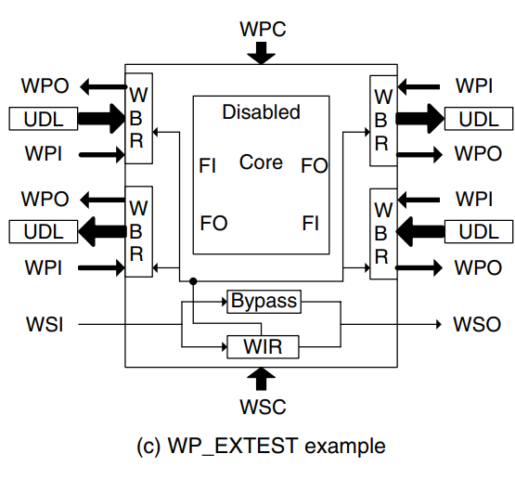
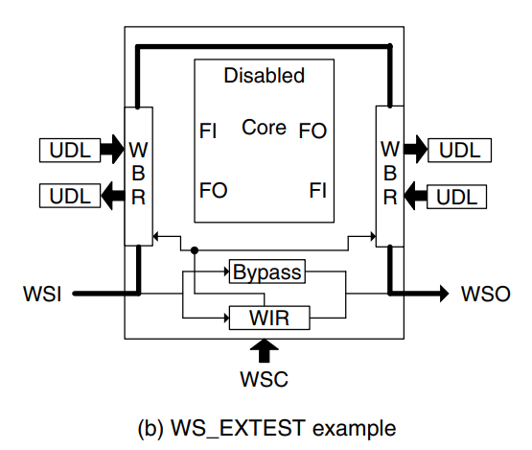
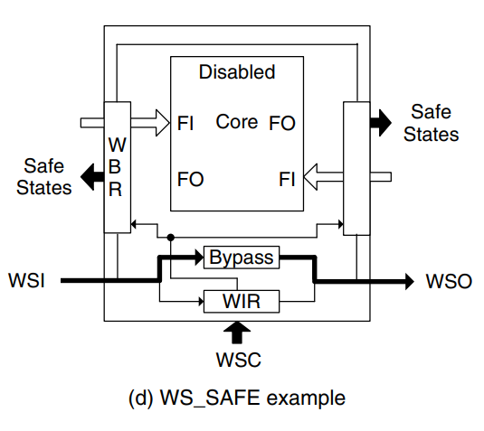
03 Embedded Core Test Standard (IEEE Std. 1500)
Instruction Set
WS_EXTEST:
This mandatory instruction allows testing of core-to-core interconnects and the off-chip user-defined logic (UDL) using a single scan chain configuration.
WS_SAFE:
This optional instruction provides a straightforward way for the core integrator to put a wrapper into a static and safe state.

Slide 65
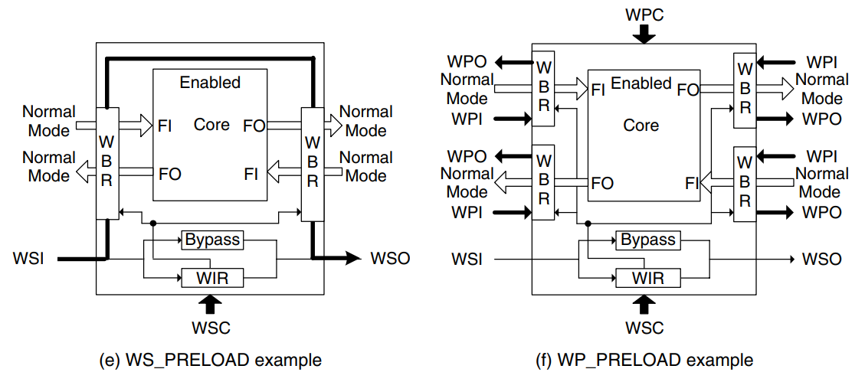
03 Embedded Core Test Standard (IEEE Std. 1500)
Instruction Set
WS_PRELOAD:
This conditionally required instruction allows test data to be serially loaded into the WBR without interfering with the operation of cores or UDL attached to the WBR.
It is mandatory when the WBR is composed entirely of cells with a shift path supporting the Shift operation that keeps the WFO terminals static.

Slide 66
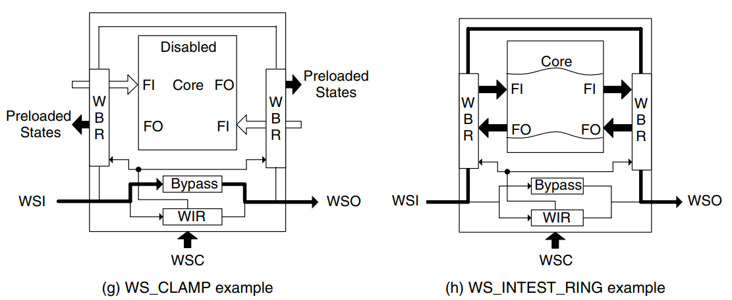
03 Embedded Core Test Standard (IEEE Std. 1500)
Instruction Set
WS_CLAMP:
This optional instruction allows the state of signals driven by the wrapper functional outputs to be determined by the data prestored in the WBR.
WS_INTEST_RING:
This optional instruction allows single-step testing of the core circuitry with each test pattern and response being shifted through the WBR.

Slide 67
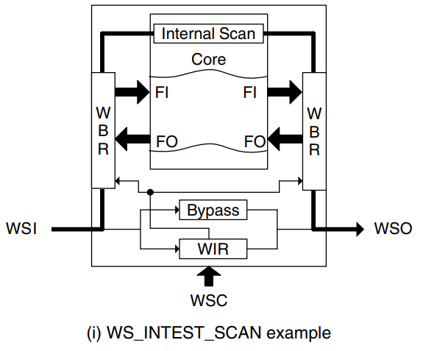
03 Embedded Core Test Standard (IEEE Std. 1500)
Instruction Set
WS_INTEST_SCAN:
It is the same as the WS_INTEST_RING instruction except that an internal scan chain of the core can be concatenated with the WBR to form a single scan chain.
For 1500, at least one INTEST instruction is required. This can be a WS_INTEST_RING, a WS_INTEST_SCAN, or a user-defined instruction with the name of Wx_TEST, where “x” can also be S, P, and H.

Slide 68
03 Embedded Core Test Standard (IEEE Std. 1500)
Core Test Language (CTL)
The core test language (CTL) is a language for capturing and expressing test-related information for reusable cores.
CTL is an extension of the IEEE 1450 Standard Test Interface Language (STIL) standard. While STIL is a language mainly for representing IC test patterns and waveforms, CTL provides additional information for core-specific controls to configure a core and its surrounding logic, as well as the requirements and constraints on the implementation of chip-level test interfaces for the core.

Slide 69
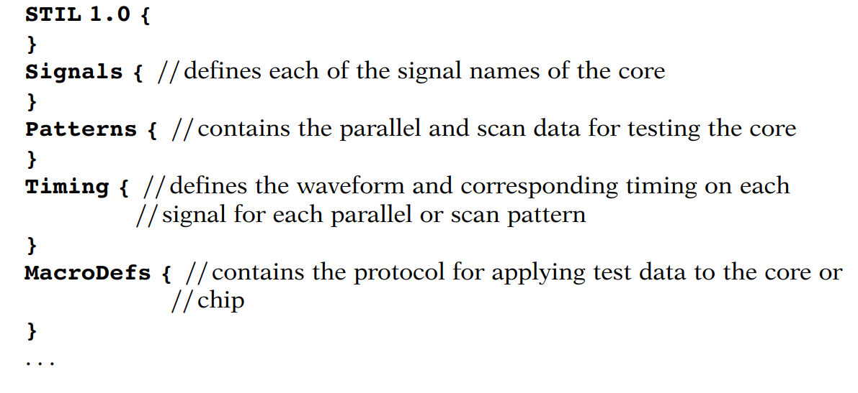
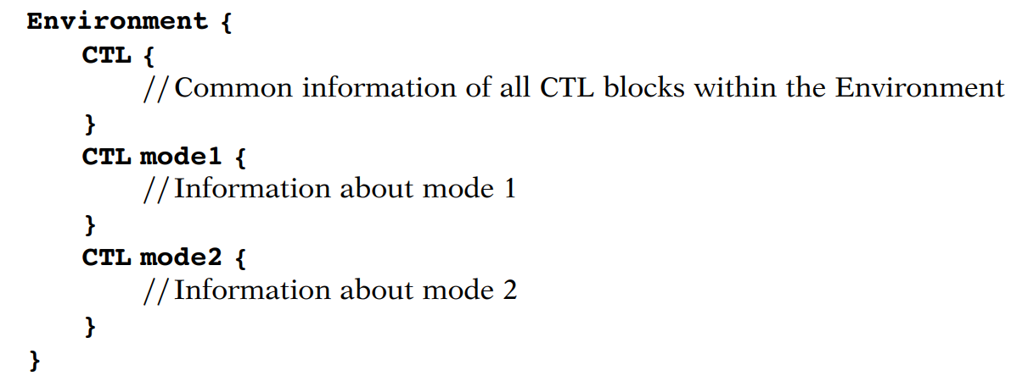
03 Embedded Core Test Standard (IEEE Std. 1500)
Core Test Language (CTL)

Slide 70
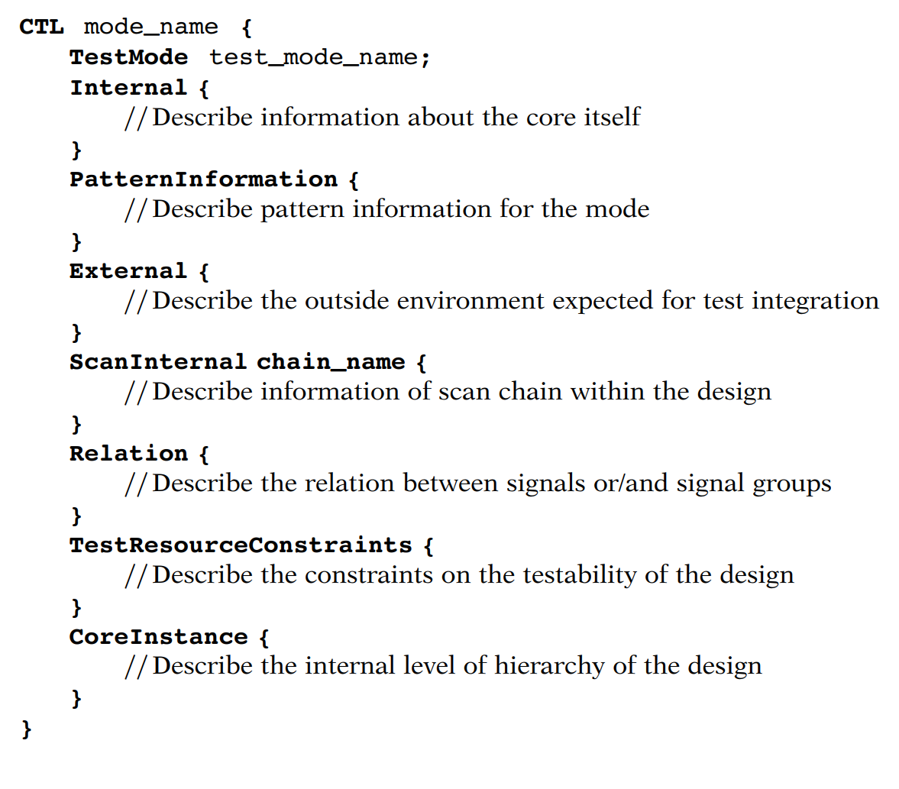
03 Embedded Core Test Standard (IEEE Std. 1500)
Core Test Language (CTL)

Slide 71
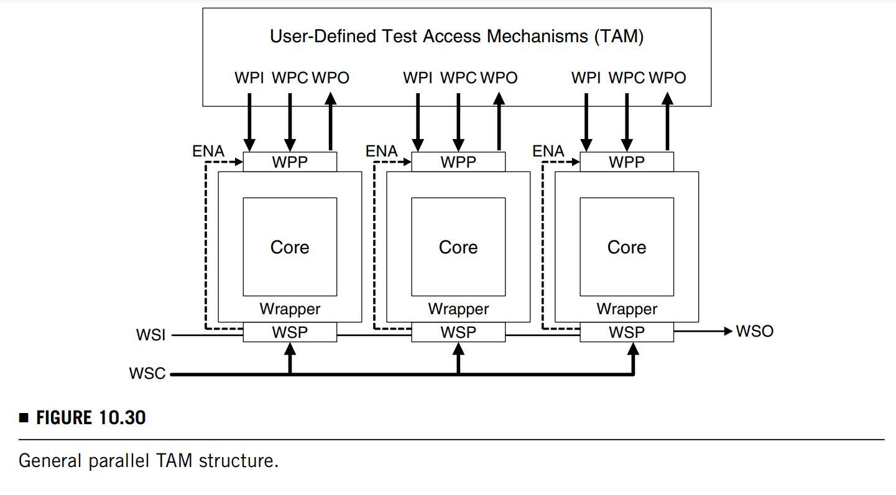
03 Embedded Core Test Standard (IEEE Std. 1500)
Core Test Supporting and System Test Configuration:
Parallel test access with the user-defined wrapper parallel port(WPP): The 1500 standard provides an efficient solution for testing the cores by allowing parallel test access with the user-defined WPP. Thus, the development of core testing in 1500 is easier than in 1149.1.

Slide 72
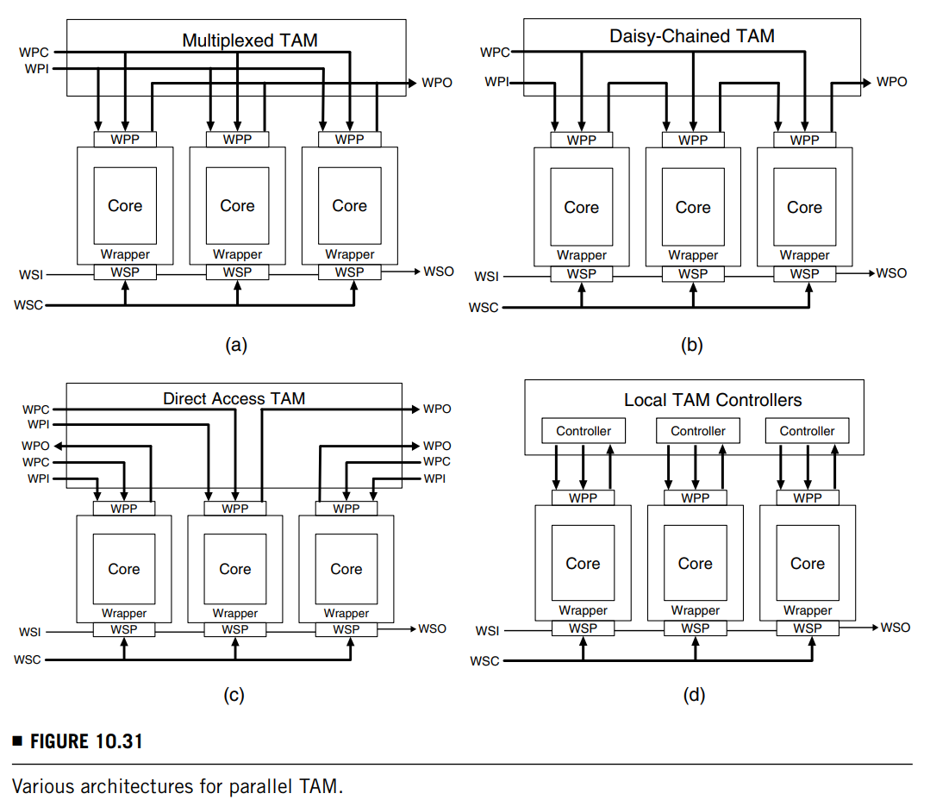
03 Embedded Core Test Standard (IEEE Std. 1500)
Core Test Supporting and System Test Configuration:
TAM being user-definable: users may design their own test enable protocols.

Slide 73
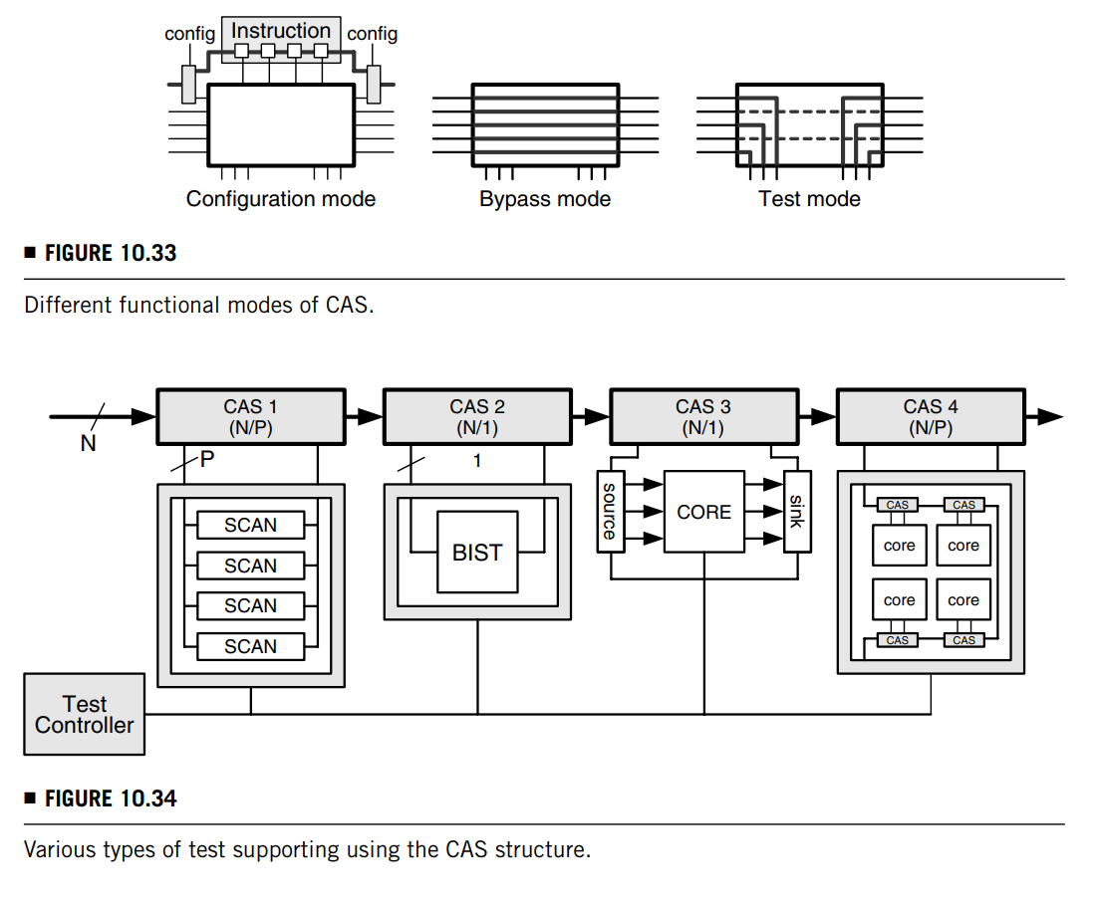
03 Embedded Core Test Standard (IEEE Std. 1500)
Hierarchical Test Control and Plug-and-Play
Core Access Switch (CAS):
Each core is wrapped by a 1500 wrapper and a CAS block is allocated to each core.
Each CAS block can be operated in the configuration, bypass, or test mode.
When testing is carried out, each core is either in the bypass mode or in the test mode. (bottom-right pic)
For a hierarchical core, the CAS technique allows the internal cores to be CAS-ed.

Slide 74
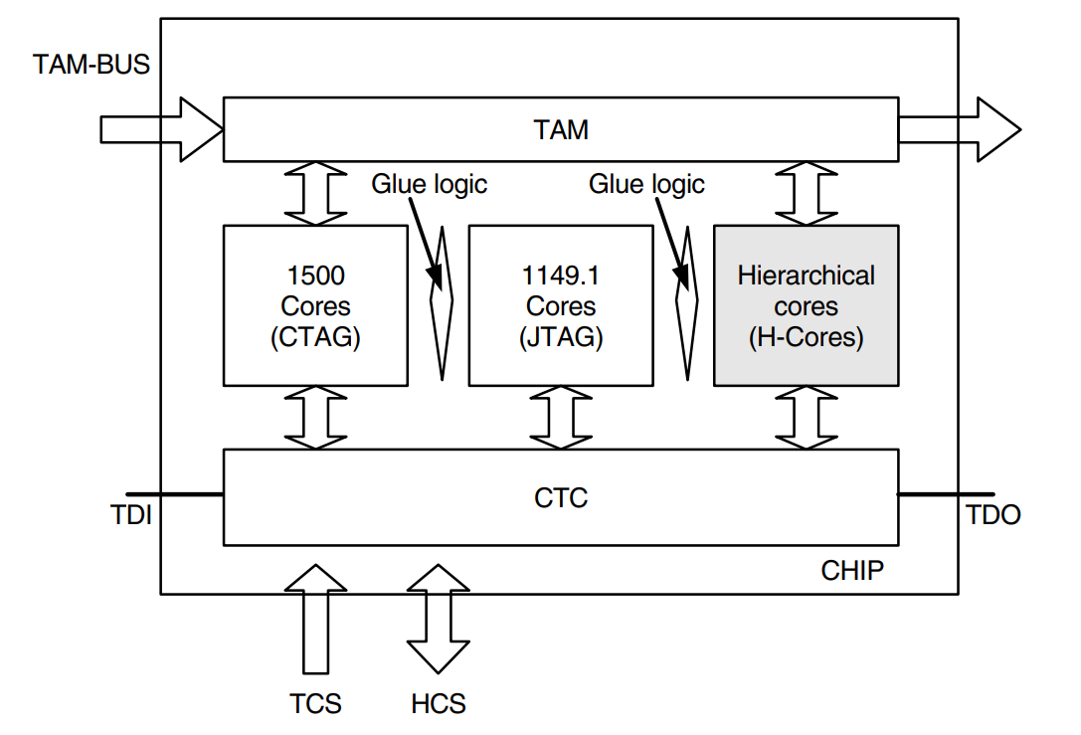
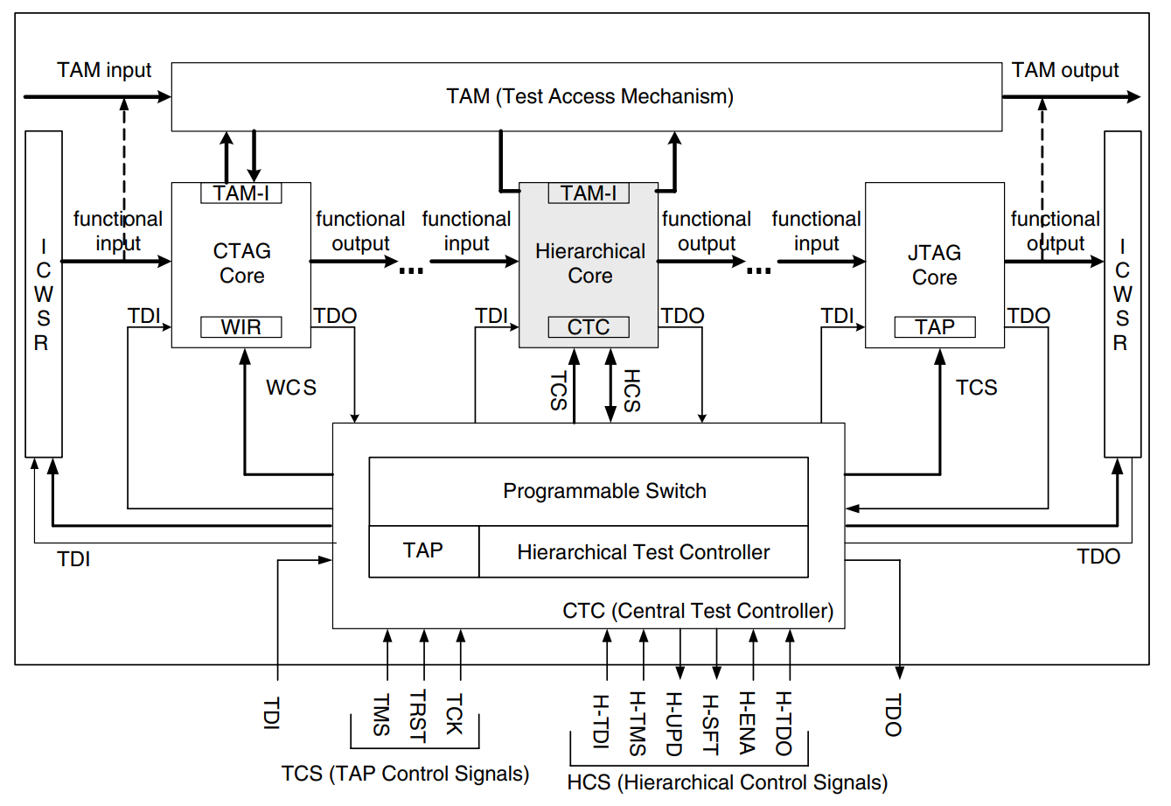
03 Embedded Core Test Standard (IEEE Std. 1500)
Hierarchical Test Control and Plug-and-Play
H-core Wrapper:
it contains:
a centre test controller (CTC) which consists of an 1149.1 TAP controller. It is the mechanism used to select the cores to be tested and to distribute test signals to the selected cores.
a hierarchical test controller (HTC)
a programmable switch which, with HTC, will determine which cores are to be tested next and then set up the appropriate connections.

Slide 75
03 Embedded Core Test Standard (IEEE Std. 1500)
Hierarchical Test Control and Plug-and-Play
H-core Wrapper:
The extra signals provided to the hierarchical cores allow the enabling of a core in a hierarchy directly from another core in an upper or lower level. This can save a lot of setup time when a new core in a hierarchy is to be tested as it is not necessary to send the new setup signals through cores outside the hierarchy.

Slide 76
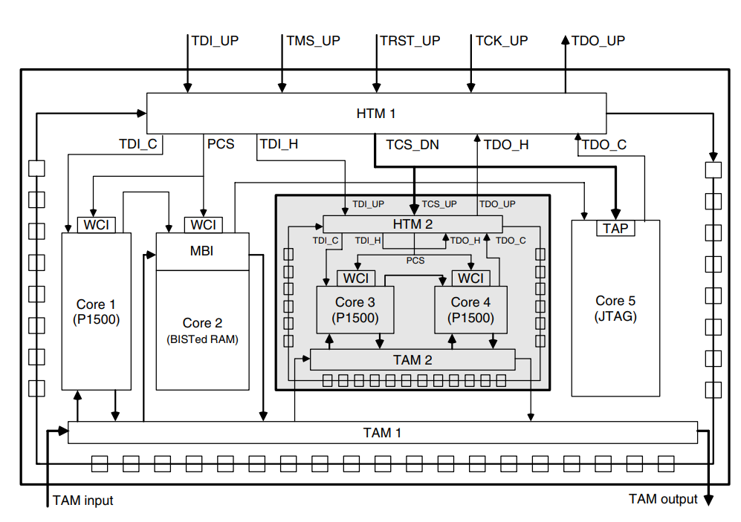
03 Embedded Core Test Standard (IEEE Std. 1500)
Hierarchical Test Control and Plug-and-Play
A hierarchical test architecture with I/Os compatible with 1149.1
A hierarchical test manager (HTM) is used to generate the test signals required by a hierarchical core so as to handle the test operations at a lower level.
The TDI_H (TDO_H) of the upper-level HTM is connected to TDI_C (TDO_C) or TDI_H (TDO_H) of the lower-level HTM, according to the types of cores to be tested.

Slide 77
Comparisons between the 1500 and 1149.1 Standards
04

Slide 78
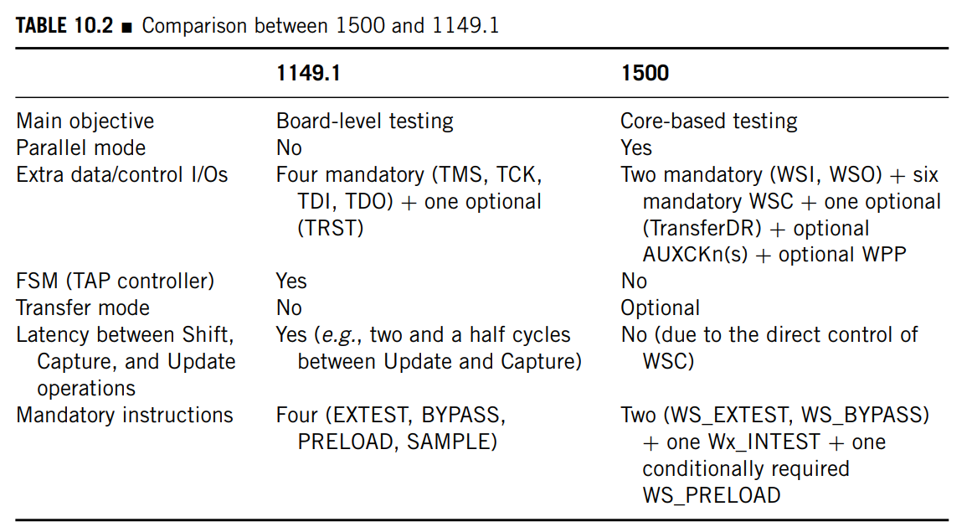
03 Embedded Core Test Standard (IEEE Std. 1500)

Slide 79
Thanks for listening!
Haochen Ding

